Slide 1
Pathophysiology
Dr.Wasfi Dhahir Abid Ali
Department of medical sciences –College of Nursing –
University of Basrah

Slide 2
Hemodynamics disorders
SHOCK

Slide 3
Definitions of shock
1- It is a state characterized by systemic hypotension , it can occur due to diminished cardiac out put or due to reduce effective circulating blood volume. It results in impaired perfusion of tissue and cellular hypoxia
2-Acute medical condition associated with a fall in blood pressure, caused by such events as loss of blood, severe burns, allergic reaction, or sudden emotional stress, and marked by cold, pallid skin, irregular breathing, rapid pulse, and dilated pupils.

Slide 4
Types of shock
Cardiogenic shock
Hypovolemic shock
Shock associated with systemic inflammation
Less common
Neurogenic shock
Anaphylactic shock

Slide 5
Cardiogenic – low cardiac out put
Intrinsic causes
1-Myocardial infarction
2-Cardiac arrhythmias
3-Cardiac myopathy
4-Rupture of the heart
b-Extrinsic compression
1-Cardiac tamponed from haemopericardium
2-Obstruction to the outflow
3- pulmonary embolism
c-Obstruction to the outflow
1- pulmonary embolism
2- Ball valve thrombus
3-Tension pneumothorax

Slide 6
Hypovolemic - loss of blood or plasma volume
Causes :
Acute hemorrhage 2- Dehydration 3-Burns 4-Acute pancreatitis
5- Excessive use of diuretics
Hypovolemia
Is a direct loss of effective circulating blood volume leading to:
1-A rapid, weak, thread pulse due to decreased blood flow combined with tachycardia
2-Cool, clammy skin due to vasoconstriction and stimulation of vasoconstriction
3-Rapid and shallow breathing due to sympathetic nervous system stimulation and acidosis
4-Hypothermia due to decreased perfusion and evaporation of sweat
5-Thirst and dry mouth, due to fluid depletion
6-Cold and mottled skin especially extremities, due to insufficient perfusion of the skin

Slide 7
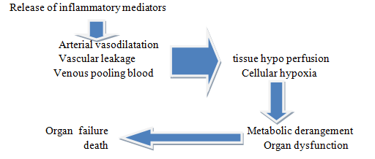
Shock associated with systemic inflammation
It is either microbial or non microbial

Slide 8
Septic shock
Caused by microbes also called endotoxic shock
Metabolic alteration in septic shock
Insulin resistance
Hyperglycemia
Gluconeogenesis
Lactic acidosis

Slide 9
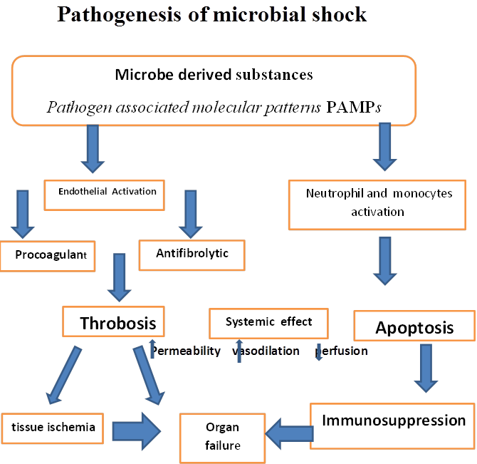
By Dr. Wasfi

Slide 10
Stages of shock
Initial stage Tissues are low perfused, decreased cardiac out put CO , Hypoxia lead to increased anaerobic metabolism, lactic acid formation.
Compensatory: Reversible. SNS activated by low CO, attempting to compensate for the decrease tissue perfusion( Activation mechanism of (ADH, Rennin angiotensin aldosterone system , conservation of fluids)
Progressive - Failing compensatory mechanisms: profound vasoconstriction from the SNS lead to ISCHEMIA Lactic acid production is high lead to metabolic acidosis.
Irreversible - Cellular necrosis and Multiple Organ Dysfunction Syndrome may occur
Death

Slide 11
Systemic Shock out come
1- Systemic lactic acidosis
2-Decreased myocardial contractility
3- Decreased vascular tone
4-Decrease blood pressure,
preload, and cardiac output

